Slide 1

6th Grade Accelerated Math
Unit 13, Lesson 8 Adding Linear Expressions with Rational Coefficients Volume 2, pg. 301

Slide 2


Benchmark
MA.7.AR.1.1
Apply properties of operations to add and subtract linear expressions with rational coefficients.
volume 2, pg. 301

Slide 3
Integrated Mathematical Thinking and Reasoning Standards
MA.K12.MTR.2.1 Demonstrate understanding by representing problems in multiple ways.
MA.K12.MTR.5.1 Use patterns and structure to help understand and connect mathematical concepts.
volume 2, pg. 301

Slide 4

Learning Target
I can add linear expressions with rational coefficients.
volume 2, pg. 301

Slide 5

Warm-Up
volume 2, pg. 302

Slide 6
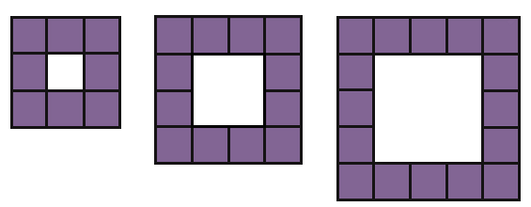
13.8.1 Warm-Up: Visual Patterns
Three figures are shown.
What pattern do you see?
Explain how many small purple squares you think will be in the next figure.
volume 2, pg. 302

Slide 7

Exploration
volume 2, pg. 302

Slide 8

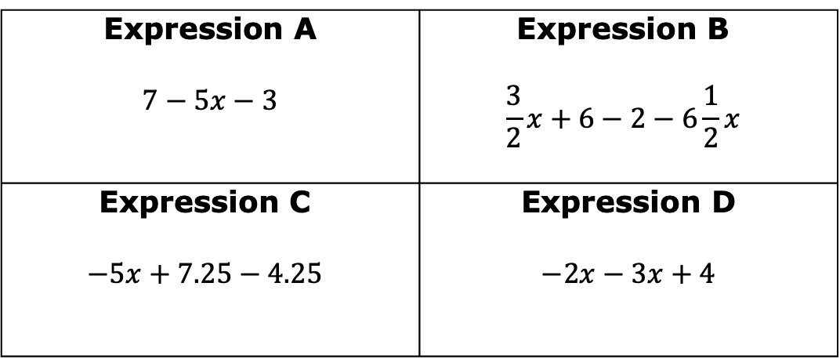
13.8.2 Exploration: Which One Doesn’t Belong?
Which expression does not belong with the other three? Explain your reasoning.
Expression A $$7−5x−3$$ | Expression B $$\frac{3}{2}x+6−2−6\frac{1}{2}x$$
Expression C $$−5x+7.25−4.25$$ | Expression D $$−2x−3x+4$$
volume 2, pg. 302

Slide 9

Collaboration
volume 2, pg. 303

Slide 10

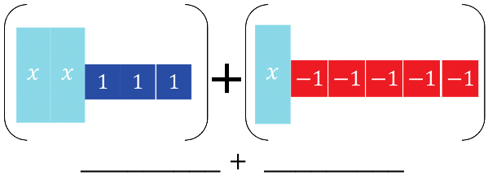
13.8.3 Collaboration: Adding Expressions with Algebra Tiles
Algebra tile representations of an expression are given. Work with your partner to find the sum by following the steps below.
On the lines, write the algebraic expression for each representation.
Rearrange the tiles to group like tiles. Draw the representation.
Eliminate any zero pairs to find the sum. Write the sum.
volume 2, pg. 303

Slide 11
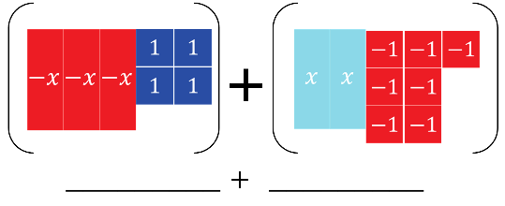
On the lines, write the algebraic expression for each representation.
Rearrange the tiles to group like tiles. Draw the representation.
Eliminate any zero pairs to find the sum. Write the sum.
volume 2, pg. 303

Slide 12

Guided Instruction
volume 2, pg. 304

Slide 13

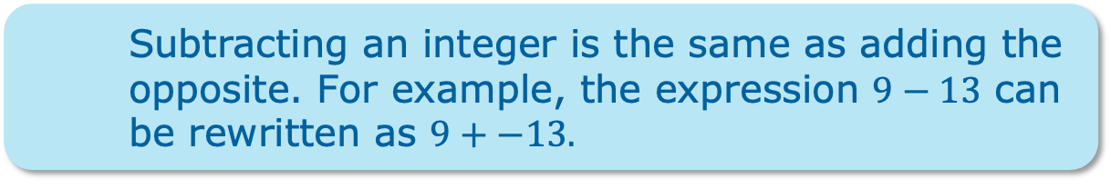
13.8.4 Guided Instruction: Adding Linear Expressions
When adding two expressions, rearrange the terms so that like terms are grouped together. Then add the coefficients of the like variable terms together and add the constants. Zero pairs are eliminated in this process.
Subtracting an integer is the same as adding the opposite. For example, the expression $9−13$ can be rewritten as $9+−13.$
volume 2, pg. 304

Slide 14
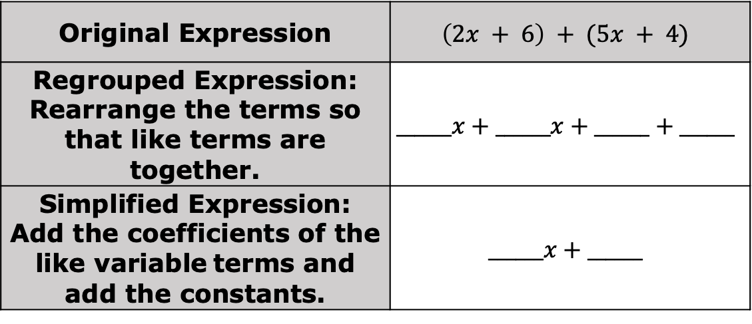
Find the sum of the two expressions.
Original Expression | $$\left(2x + 6\right) + (5x + 4)$$
Regrouped Expression: Rearrange the terms so that like terms are together. | $$______x+______x+______+______$$
Simplified Expression: Add the coefficients of the like variable terms and add the constants. | $$______x+______$$
volume 2, pg. 304

Slide 15
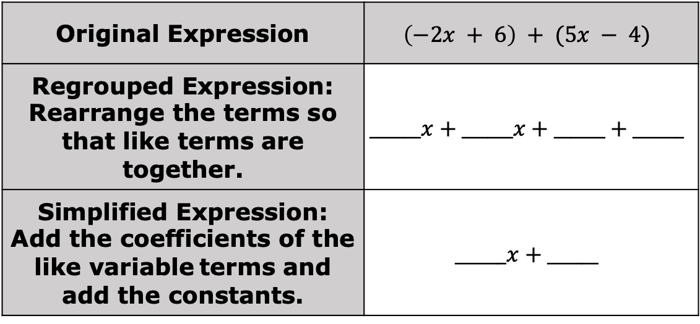
Original Expression | $$\left(−2x + 6\right) + (5x − 4)$$
Regrouped Expression: Rearrange the terms so that like terms are together. | $$______x+______x+______+______$$
Simplified Expression: Add the coefficients of the like variable terms and add the constants. | $$______x+______$$
volume 2, pg. 304

Slide 16
Collaboration
volume 2, pg. 304

Slide 17
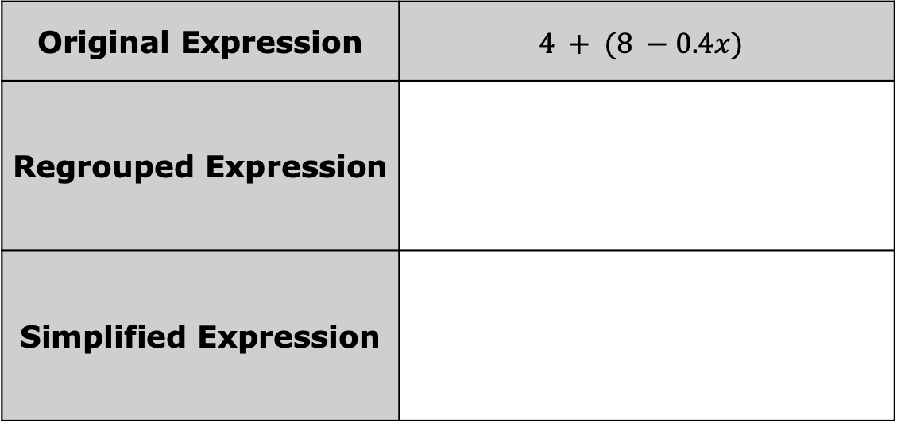
13.8.5 Collaboration: Adding Linear Expressions
1. Work with your partner to find the sum of the two expressions in simplest form.
a.
Original Expression | $$4 + (8 −0.4x)$$
Regrouped Expression
Simplified Expression
volume 2, pg. 304

Slide 18
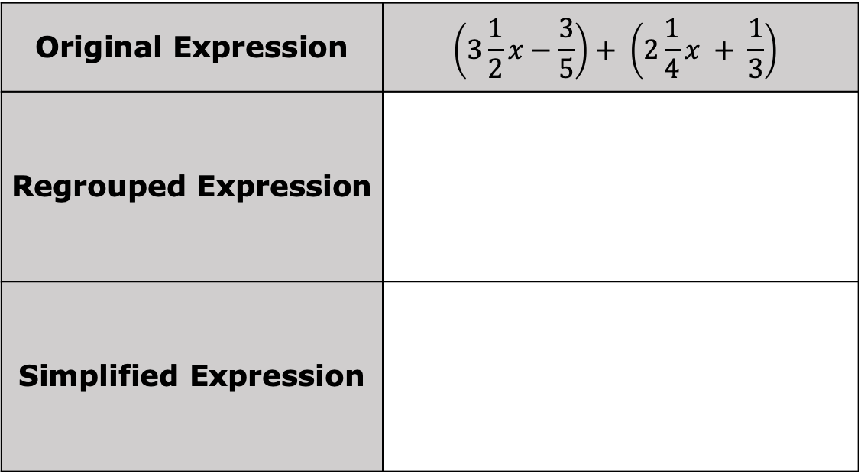
Original Expression | $$\left(3\frac{1}{2}x−\frac{3}{5}\right)+ \left(2\frac{1}{4}x + \frac{1}{3}\right)$$
Regrouped Expression
Simplified Expression
volume 2, pg. 304

Slide 19
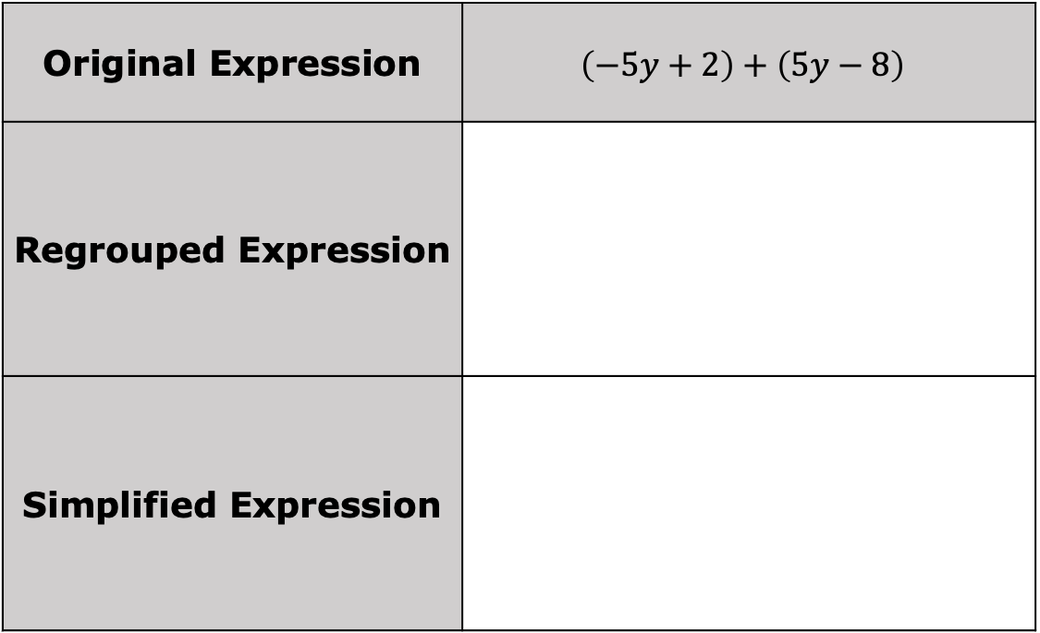
Original Expression | $$\left(−5y+2\right)+\left(5y−8\right)$$
Regrouped Expression
Simplified Expression
volume 2, pg. 304

Slide 20

Original Expression | $$(0.7−2.4x)+(4.1x−5.32)$$
Regrouped Expression
Simplified Expression
volume 2, pg. 305

Slide 21
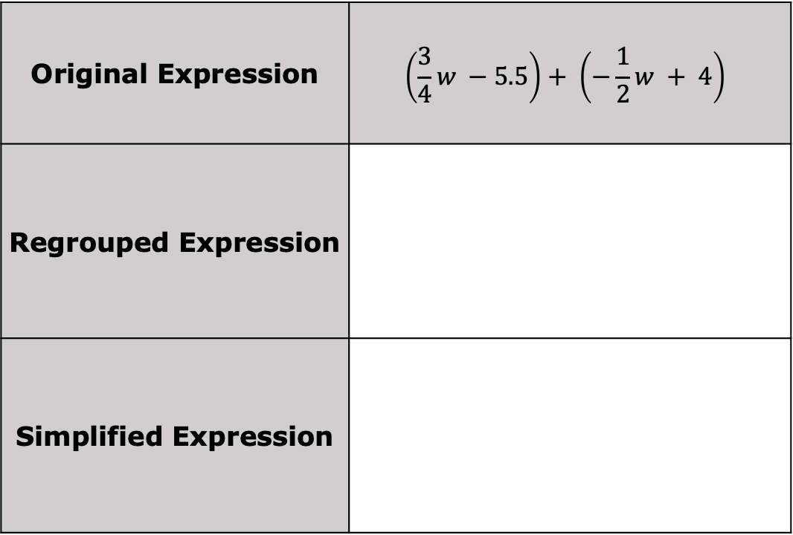
Original Expression | $$\left(\frac{3}{4}w −5.5\right)+ \left(−\frac{1}{2}w + 4\right)$$
Regrouped Expression
Simplified Expression
volume 2, pg. 305

Slide 22

Your Turn
volume 2, pg. 306

Slide 23
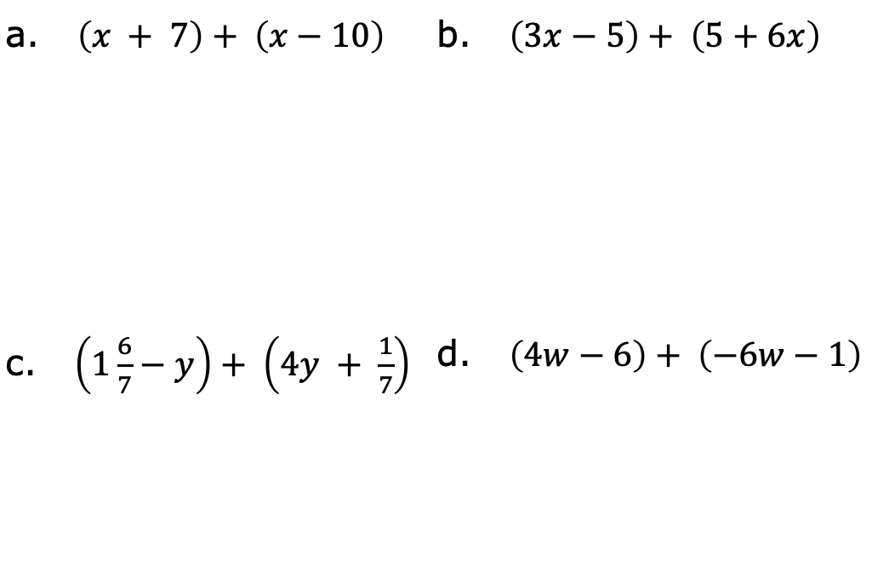
13.8.6 Your Turn!
Find the sum of each expression using the fewest terms possible.
a. $\left(x + 7\right)+ \left(x−10\right)$ | b. $\left(3x−5\right)+ \left(5+6x\right)$
c. $\left(1\frac{6}{7}−y\right)+ \left(4y + \frac{1}{7}\right)$ | d. $\left(4w−6\right)+ \left(−6w−1\right)$
volume 2, pg. 306

Slide 24
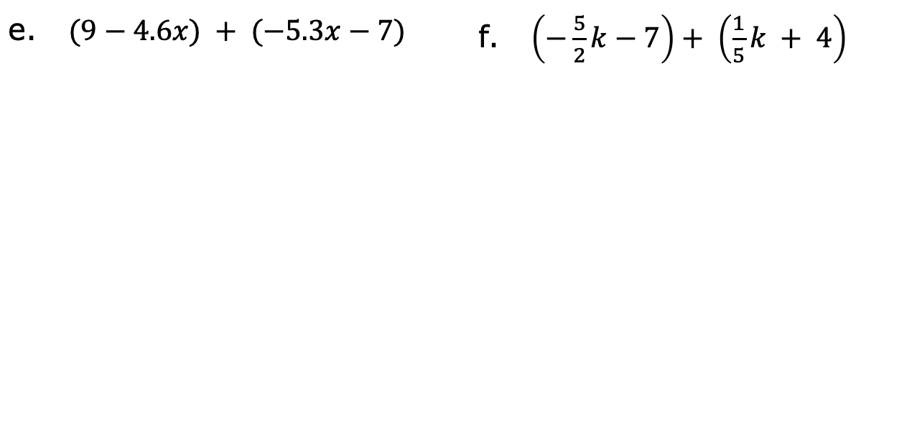
e. $(9−4.6x) + (−5.3x−7)$ | f. $\left(−\frac{5}{2}k−7\right)+ \left(\frac{1}{5}k + 4\right)$
volume 2, pg. 306

Slide 25

Wrap-Up
volume 2, pg. 307

Slide 26
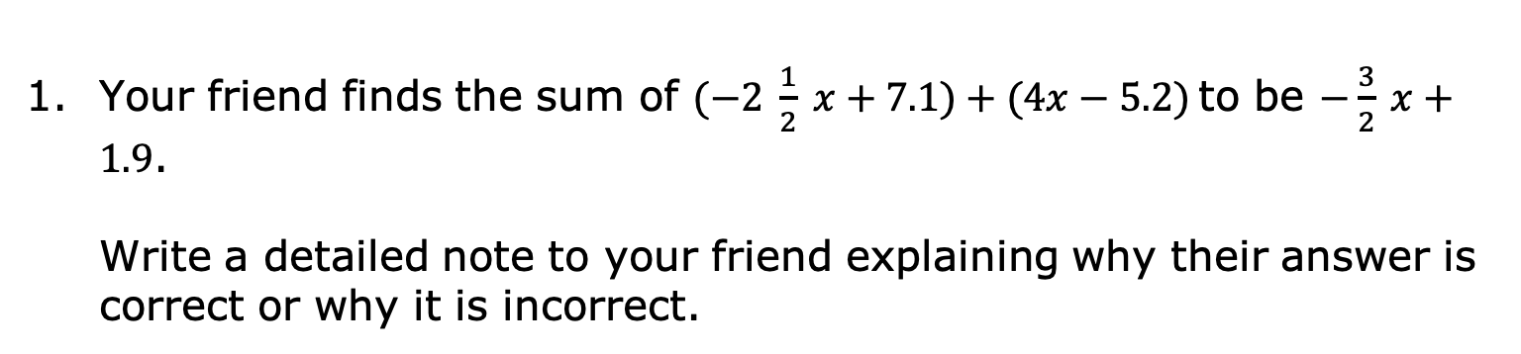
13.8.7 Wrap-Up: Error Analysis
Your friend finds the sum of $(−2 \frac{1}{2} x+7.1)+(4x−5.2)$to be $−\frac{3}{2} x+1.9$.
Write a detailed note to your friend explaining why their answer is correct or why it is incorrect.
volume 2, pg. 307

